Slide 1
« The voice of the European Service Industries for International Trade Negotiations in Services »
European Economic and Social Committee
Hearing in the framework of the
EESC opinion
on Investment Protection and ISDS
in EU Trade and Investment Agreements
3 February 2015 –
EESC – Meeting room JDE 52 – 99-101, rue Belliard 99-101
SESSION 1: The EU approach to investment protection and ISDS - a chance for reform? (the case of the EU-Canada Free Trade Agreement –CETA)
Pascal Kerneis – Managing Director
European Services Forum

Slide 2
1) The EU is by very far the biggest investor in the World
EU FDI (Stocks) = 40,3% of Global FDI ! = 10,6 Trio $
Y2013 - Source: UNCTAD WIR - 2014

Slide 3
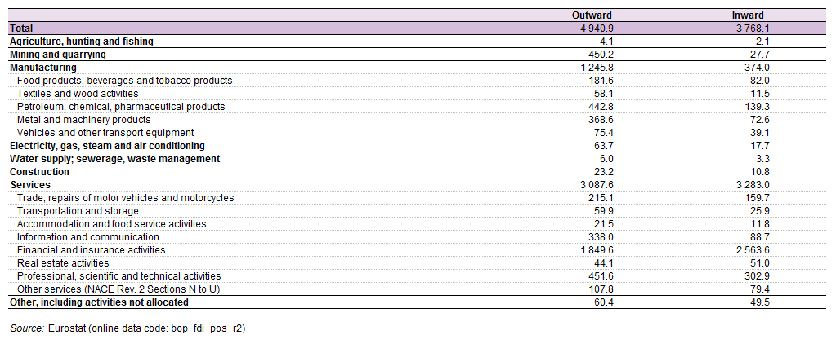
Services sectors = Biggest investors (60%)
Extra EU-27 FDI stocks by economic activity, EU-27, end 2011 (billion EUR)
62,5%
37,5%

Slide 4
Some general facts about BITs and ISDS
2013:
Total Outward FDI
26 312 Trio $
104 000 investing MNCs
892 000
Foreign Affiliates worldwide
Source: Unctad
2013:3236 BIT worldwide
(Incl. 1557 by EU)
608 known ISDS Cases,
Incl. 50% from EU Companies,
22% from US Companies
Average duration of ISDS Cases: before 2003: 3,5Y
Since 2003: 2,6y
Out of 274 concluded cases
43% in favour of States
31% in favour of Company
26% settled
Out of 90 concluded cases in 10y (2003-2013), 46% settled, 37% in favour of States, 18% in favour of Company!(16 cases!)

Slide 5
ESF General Position on Investment Protection
EU is in deep economic crisis, and needs to attract & encourage FDI to create jobs and Growth.
➔ 2 jobs out of 10 in Services are linked to international activities (i.e. approx. 35 Mio European jobs!)
EU needs to provide TRUST to Investors.
ESF strongly supports a good protection of EU companies FDI via trade and investment agreements.
ESF astonished by the total shift of EU policy compared to Member States policy:
➔ M.S. BIT spirit = “Protection of the investors”
➔ EU BIA Spirit = “Protection of the EU against potential abuses of foreign investors” !

Slide 6
On Investment Protection (1)
Too precise definitions might increase the number of cases, not diminish them!
➔In CETA, unclear wordings on “claims for money” related to sales of goods & services, or “management contracts” (Not in EU-SG FTA)
Non-discriminatory treatment for investors
➔All sectors must be covered! No filter mechanism
Fair and equitable treatment (FET), better than “International Customary Law”
In CETA “legitimate expectations” removed!
Need to clearly cover activities related to that investment (e.g. public procurement contracts)

Slide 7
On Investment Protection (2)
Direct & Indirect expropriation must be covered
In CETA & SG: Reversal of the burden of the proof!
“only public welfare measures which are “manifestly excessive in light of their purpose” could constitute indirect expropriation.” = less protection!
New Bidding “interpretative guidance for arbitrators” that can be reviewed by “Committee on Services and Investment” ! Politisation of the rules… Changing the rules, …to provide less protection to investors… Legal certainty???

Slide 8
On Investor-State Dispute Settlement
Essential element of ISDS = Neutrality of the arbitration court – “Depolitisation” is a must.
Government and regional/local authorities do make mistakes! Or voluntary Government decisions against foreign firms only = discrimination. Link between:
➔Protectionism: from 2003-2013, the most frequent respondents in ISDS cases are Argentina (43) and Venezuela (33) ; and
➔weak legal framework: See WEF’s index Efficiency of Legal Framework: Argentina: 147th;Venezuela:148th (out of 148).
Local administrative courts are not always neutral, and more subject to corruption:
90% of contested acts in ISDS are local authorities decisions

Slide 9
On ISDS Reform Proposal (1)
No ISDS is not an option.
➔ No ISDS could lead to denial of justice, when the domestic courts are not allowed to receive/judge on International law provisions that are not enshrined in domestic law. Better not to have investment protection chapter in the FTA
State-to-State Dispute Settlement Mechanism as alternative: Not an option either
➔ Major risk of “politisation” of a case (arbitrary nature of diplomatic protection, risks elevating economic dispute to ‘higher’ political level, decision not based on rules of law, risk of denial of justice if home state decides not to pursue, etc.)
No exhaustion of all domestic remedies before ISDS

Slide 10
On ISDS Reform Proposal (2)
Right to regulate: Yes…
➔ No company ever prevented a country to regulate!
ISDS tribunal cannot repeal a domestic act. It can only provide compensation if the defending state is breaching its obligation.
While Domestic Administrative Courts can repeal an act!
More transparency in the proceedings:
Yes, For New transparency rules (UN Working Group for international trade law of UNCITRAL); e.g. publication of cases, public hearings, amicus courier
➔ But need to protect confidential information and maintain the integrity of the arbitral process (caution on publication of witness statements, expert reports, skeleton arguments, etc.)
Not done for the domestic courts cases! Why?
Filter mechanism to get access to ISDS: No, but in CETA, filter for Financial services sector (38% EU FDI!). Not in EU-SG FTA

Slide 11
On ISDS Reform Proposal (3)
Consultation and Mediation and Alternative Dispute Resolution : Yes, but caution of “politisation”, and should not lengthen the process
No frivolous claims: Yes, necessary.
Aggregate 9 month cooling-off period before initiation of arbitration is too long (in CETA and SG)
Code of conduct for arbitrators: Yes, good idea.
Roster of arbitrators: Yes, for the EU, but if the chairperson of the panel must come from the roaster, it means not neutral! (risk of “politisation”)
Setting up an Appellate Mechanism: Yes, no objection

Slide 12
Thank you for ATTENTION !
Pascal KERNEIS
Managing Director
European Services Forum – ESF
168, Avenue de Cortenbergh
B – 1000 – BRUSSELS
Tel: + 32 2 230 75 14
Fax: + 32 2 320 61 68
Email: esf@esf.be
Website: www.esf.be

