Slide 1
« The voice of the European Service Industries for International Trade Negotiations in Services »
SESSION THREE: Issues related to services, investment and public procurement

Slide 2
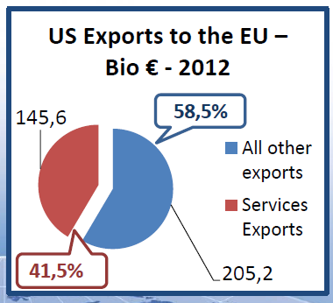
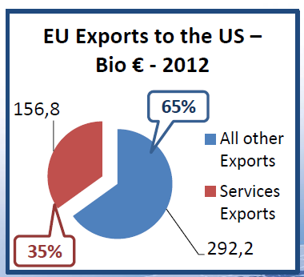
EU-US = Importance of services in each economies

Slide 3
TTIP Mandate & Regulatory Cooperation
Reducing non-tariff barriers, so-called "behind-the-border" barriers, will have to be the key part of trans-Atlantic trade liberalisation. As much as 80% of the total potential gains come from cutting costs imposed by bureaucracy and regulations, as well as from liberalising trade in services and public procurement. (Source: Commission fact sheet after adoption of High Level WG Report)
“Regulatory Coherence :
The Agreement will include cross-cutting disciplines on regulatory coherence and transparency for the development and implementation of efficient, cost-effective, and more compatible regulations for goods and services, including early consultations on significant regulations, use of impact assessments, evaluations, periodic review of existing regulatory measures, and application of good regulatory practices.”
“Sectoral provisions :
The Agreement will include provisions or annexes containing additional commitments or steps aimed at promoting regulatory compatibility in specific, mutually agreed goods and services sectors, with the objective of reducing costs stemming from regulatory differences in specific sectors, including consideration of approaches relating to regulatory harmonisation, equivalence, or mutual recognition, where appropriate.” (Source: TTIP Mandate)

Slide 4
ESF is calling for clear commitments in favour of strong commitments for regulatory cooperation covering services in TTIP:
Horizontal chapter: The horizontal framework establishing the regulatory cooperation process should cover all services regulators, wherever they are.
➔ At this stage, no proposal to cover non-central acts !
Sector specific chapters or annexes: Services chapters on Financial Services, Telecommunications and e-commerce, professional services, etc.
➔ At this stage of the talks, no specific annexes on Services!
(whiles 9 on goods!) So, may be could be handled in chapters?
Financial services Regulatory Cooperation in that crucial sector must be included, either as a specific annex or in the FS chapter: 80% of global financial transactions are made by the EU & US.
➔ At this stage, US Treasury says NO

Slide 5
Where are the Regulators of the Services Sectors in the US?
“Central Level”, i.e. Federal level
Financial services (banking & Asset Management) = Regularoy cooperation in TTIP?
= US Treasury says NO
Maritime Services transport: “Jones Act” = No; Port services = Public monopolies = No
Aviation Services: Federal Aviation Administration (FAA) = No
Telecom services: Federal Commission on Communications (FCC) = ? May Be?
Accounting standards = Financial Accounting Standards Board (FASB) = May Be ?
“Non Central Level”, i.e. State level = The competent regulatory authorities in charge of delivering licences are located in the 50 US states.
Insurance services,
Legal services,
Architectural services,
Engineering services,
Accounting services,
+ more than 100 professional and business services…
➔ Regulatory Cooperation in TTIP? NO, because the regulators are at state level? But EU Directives = Single Market legislation at central level!
So Regulatory Cooperation in TTIP for services sectors is a real Challenge!

Slide 6
THANK YOU FOR YOUR ATTENTION !
Pascal KERNEIS
Managing Director
European Services Forum – ESF
168, Avenue de Cortenbergh
B – 1000 – BRUSSELS
Tel: + 32 2 230 75 14
Fax: + 32 2 320 61 68
Email: esf@esf.be
Website: www.esf.be

