Slide 1

















EU Trade in Services in Figures
Sponsors of the event:
Think-Tank Partner
Public Affairs Partner
@EUServicesForum
esf@esf.be
European Services Forum EU

Slide 2













Trade in Services:
The Real Beating Heart of World Trade
EU Trade in Services in Figures - 2024
€3 Trillion per Year
Services: 37,5%
EU No. 1
23 Million Jobs
€ 191 Bio
Global trading
Partner
Trade in Services
EU Exports & Imports
EU Total Trade
(Goods & Services)
EU = 23%
EU Surplus of Trade in Services
58%
of World Services Exports
of export-related jobs
EU = +€17 Tri
Outward FDI
Exports = +8,9%
Exports = +5700%
Imports = +6,9%
Imports= +4400%
80% of which comes from Services +€13 Tri
EU Trade in Services in 2024
Drives EU Growth for last 25 Years
(Employer's Group)
Think-Tank Partner
Public Affairs Partner

Slide 3
Trade in Services:
The Real Beating Heart of World Trade
TOP 20 WORLD EXPORTERS OF TRADE IN SERVICES
EU is the first largest global exporter of services (23% of global services trade)
Total World Export of services 2024 (excl. Intra EU) = 7 088 Bio US$ - Source: WTO Trade Statistical Review & Global Trade Outlook 2025 – Bio US$

Slide 4
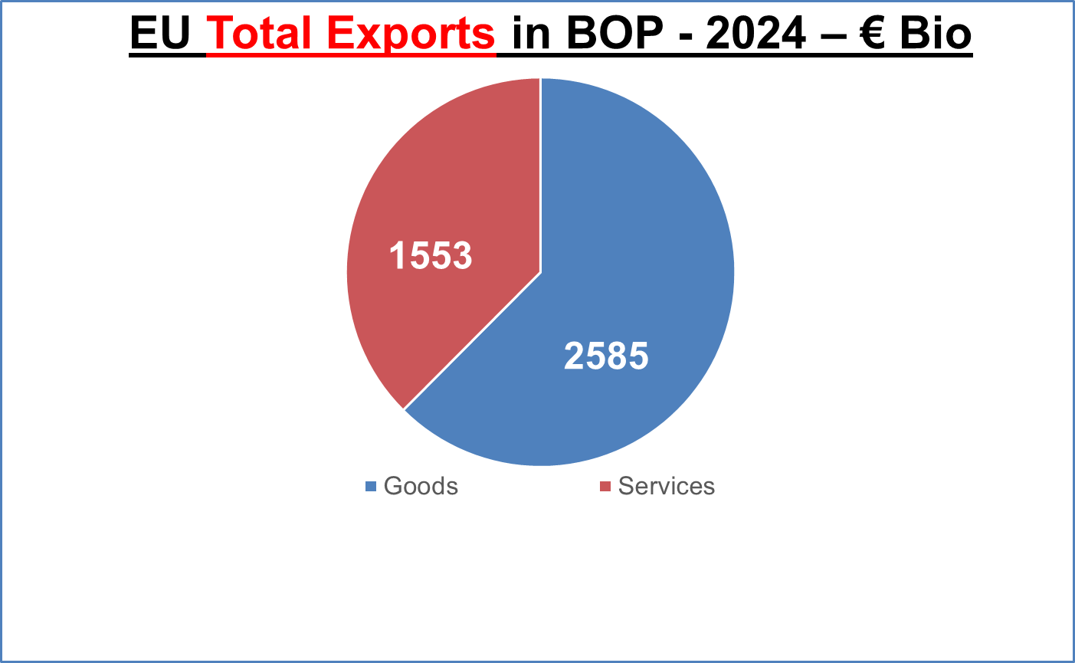
Trade in Services:
The Real Beating Heart of World Trade
EU Total Exports in BOP - 2024 - € Bio
37.5%
62.5 %
EU Total Trade Volume (Exp. & Imp) in 2024 = 2.91 Trillion € - i.e. 7.98 Billion€/day

Slide 5
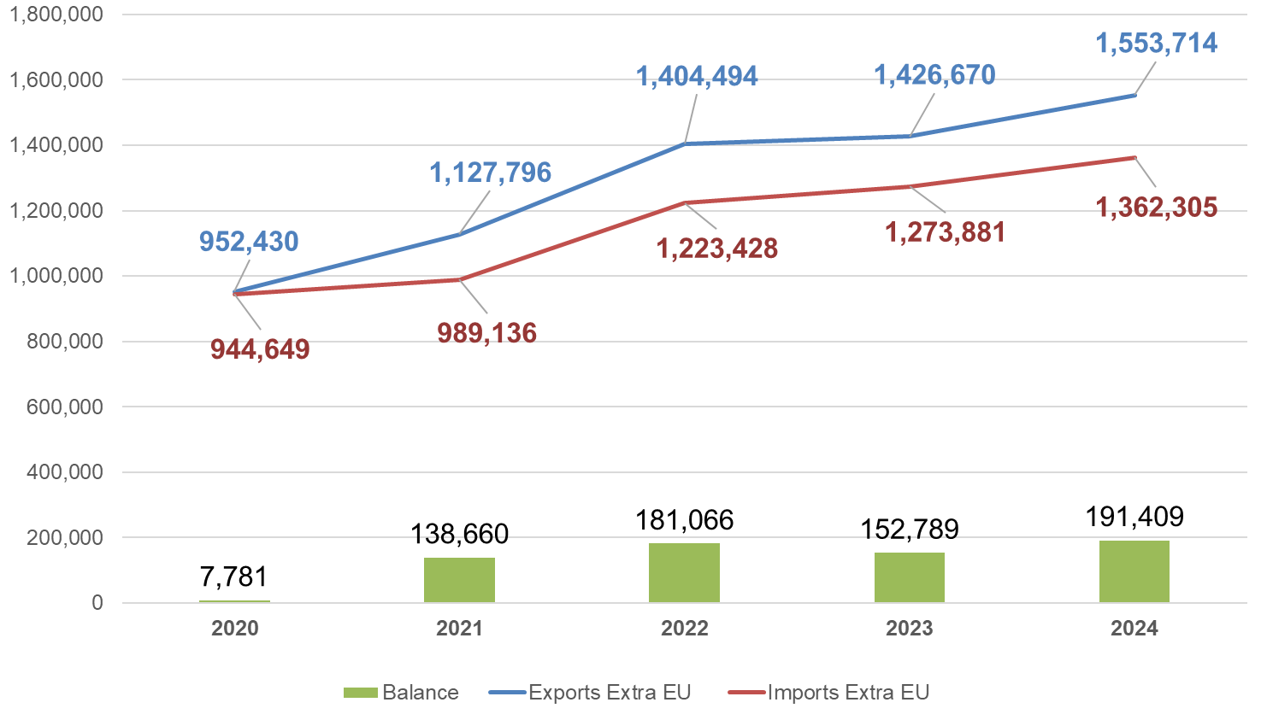
Trade in Services:
The Real Beating Heart of World Trade
Evolution of EU27 Global Trade in Services (Extra-EU – 2020-2024 – € Mio)
Exports: + 8,9% in 2024
Imports: +6,9% in 2024
EU Exports of services = +8,9% growth in 2024
EU Surplus of trade in services = €191 Billion

Slide 6
Trade in Services:
The Real Beating Heart of World Trade
Evolution of EU exports of Trade in Services in 25 Years/ ESF Inception
Exports: + 5 761% in 25 years
Imports: + 4 405% in 25 years

Slide 7
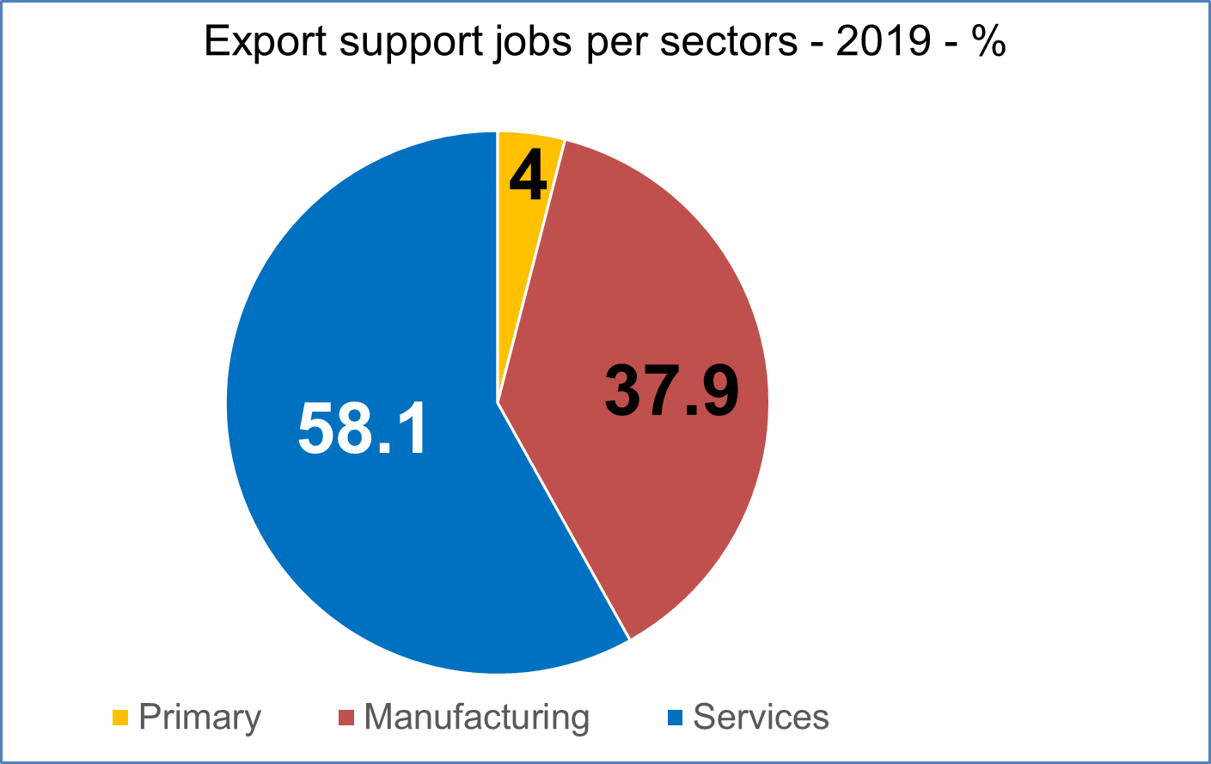

Trade in Services:
The Real Beating Heart of World Trade
Export Support Jobs per Sectors - 2019 - %
22.1 million jobs
EU Exports support 38.1 million jobs
58.1% of export-related jobs are in services
Source: European Commission Report - EU exports to the world: effects on employment - 2021

Slide 8
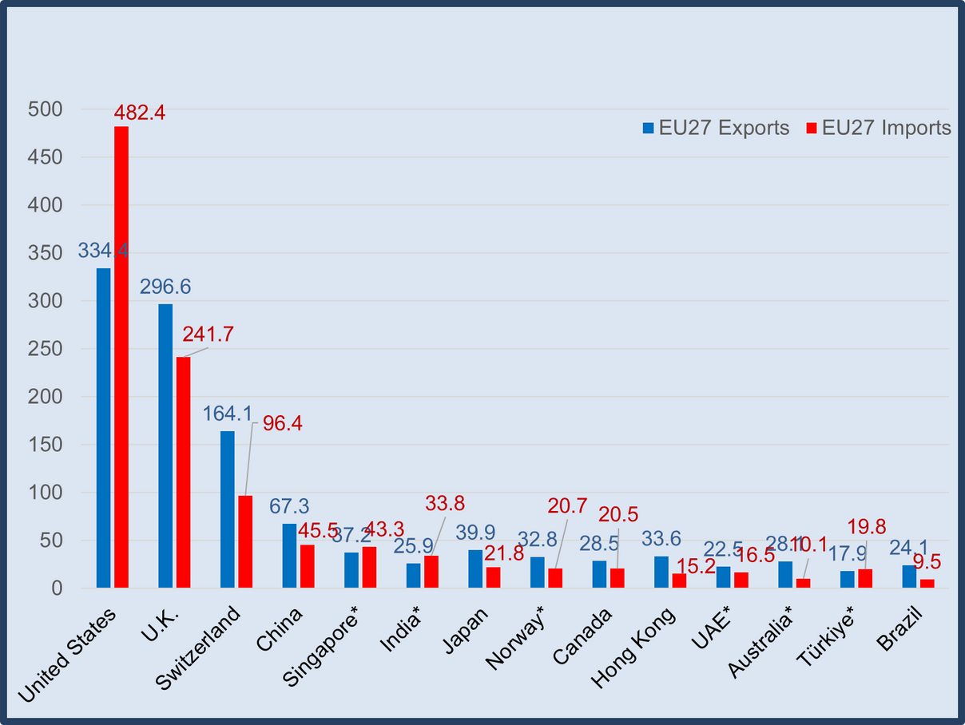
Trade in Services:
The Real Beating Heart of World Trade
TOP 10 EU TRADING PARTNERS IN SERVICES (EXTRA-EU27) – 2024 - €BIO
EU Exports to USA,
UK & Switzerland = 51% of total EU Exports
Source: Eurostat bop_its6_det.

Slide 9
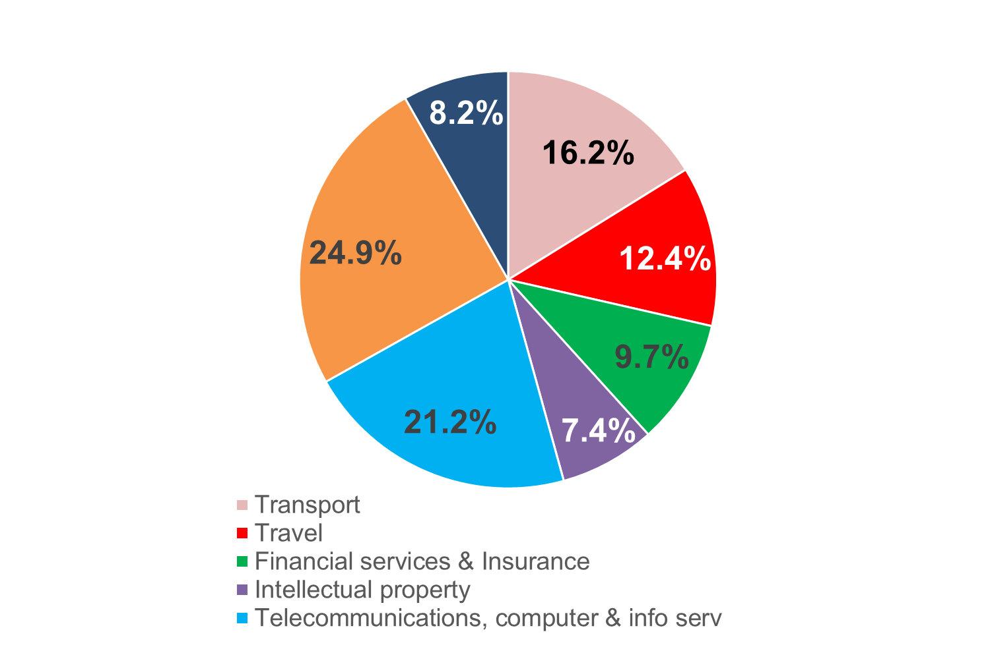
Trade in Services:
The Real Beating Heart of World Trade
EU Services Exports per Sectors - 2024 - %
Transport
Intellectual Property
Financial Services & Insurance
Other Services (manuf. Cult, Const, etc.)
Telecommunications, Computer & Info Services
Other Business Services
Travel & Tourism

Slide 10
Trade in Services:
The Real Beating Heart of World Trade
TOP 6 WORLD BIGGEST INVESTORS (OUTWARD FDI STOCK – US$ Bio)
EU is the first largest global investor
(30.6% of total)
+77% of Outward FDI comes from Services sectors
Source: UNTAD Stat
(World Outward FDI in 2024= $43,6Trio)
Source: Eurostat bop_fdi6_pos

